Slide 1

Managing the Sidelines
References:
NFHS 2021 Football Rules Book
NFSH 2021 Football Case Book
Football Officiating Mechanics Illustrated, NMOA 2020 (4 Person Crews)
High School Football Rules Simplified & Illustrated
The Redding Study Guide to NFHS Football Rules 2019
Steve Wagner
sewagne@gmail.com
505-400-6384

Slide 2
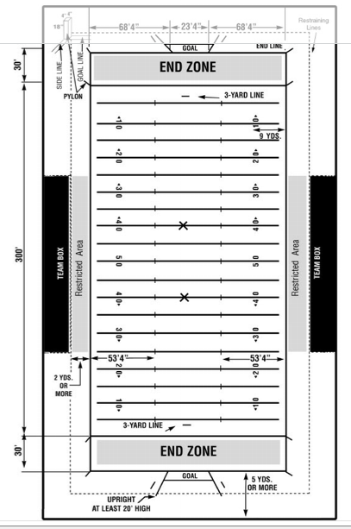
Field Diagram

Slide 3
Team Box and Coaches Area
1-2-3g Team boxes shall be marked on each side of the field outside the coaches’ area between the 25-yard lines for use of coaches, substitutes, athletic trainers, etc., affiliated with the team. The coaches’ area is a minimum of a 2-yard belt between the front of the team box and the sideline, and becomes a restricted area when the ball is live.
Note: Due to COVID-19, the team box has been expanded to the area between the 10-yard lines.

Slide 4
Team Box and Coaches Area
9-8-3: A nonplayer shall not be outside his team box unless to become a player or to return as a replaced player. A maximum of three coaches may be in the restricted area. No player, nonplayer or coach shall be in the restricted area when the ball is live.
Reference: 9-8-3 p242 High School Football Rules Simplified & Illustrated
If a player, coach or nonplayer is in the restricted zone while the ball is live but does not contact a game official:
1st offense: warning
2nd offense: 5-yard penalty
3rd and subsequent offenses: 15 yard penalty (these are Unsportsmanlike penalties assessed against the head coach) see Case Book 9-8-3 Situation A

Slide 5
Unsportsmanlike Conduct by Non-Players
9-8-1: No coach, substitute, athletic trainer or other team attendant shall act in an unsportsmanlike manner once the game officials assume authority for the contest. Examples are, but not limited to: (see page 72 HS Rule Book)
Reference: 9-8-1 p241 High School Football Rules Simplified & Illustrated
1st offense: (S38-29) – UC 15 yard penalty
2nd offense: (S38-29-47) – UC 15 yard penalty.
A second offense by the same member of the coaching staff will cause the coach to be disqualified and removed from the stadium area. He may not be in communication with players or coaches for the remainder of the game.

Slide 6
Unintentional contact with a game official
9-4-8: Unintentional contact with a game official in the restricted area while the ball is live.
1st offense: (S38-29) – 15 yards – Nonplayer foul.
2nd offense: (S38-29-47) – 15 yards from the succeeding spot and disqualification of the head coach. Arts. 1, 2, 3, 4, 5, 6, 7 or 8 – Disqualification also if any fouls under these articles are judged by the game official to be flagrant

Slide 7
Unsportsmanlike Conduct Charged to the Head Coach
Reference: Redding p 105
A player is using illegal equipment (1-5-4, 9-8-1h)
A team is not ready to begin either half (9-8-1g)
A team fails to be on the field for the mandatory three-minute warm-up period (9-8-1g)
There is a 3rd non-contact violation of the restricted area for individuals being outside the team area (1-2-3g, 9-8-1k, 9-8-3)

